Slide 1
Predicting Wage by Club & Player Attributes
Justo Garcia Miranda Heyer James Kistner Cady Stringer

Slide 2

Dataset
FIFA ‘19 Player Statistics
18,000 players
90 attributes
Place your screenshot here
Notes:
Attributes include, Overall skill rating, height, weight, preferred foot, international reputation, and position to name a few.

Slide 3
Business Use Case
Soccer team management can use our model to predict what a player is worth before negotiating a contract
Better allocate market cap (all the money they have for player salaries) to players
Helps them decide when to splurge and when to save
Notes:
In soccer/Fifa, teams have a market cap so that the playing field is leveled, meaning they all have a certain limit that they can spend on players for their squads.
With our model, the management of a soccer team could decipher more accurately how to go about spending the team’s market cap. Whether it be spending a few hundred million on a national star versus spending 20-40 million on 4 new players.

Slide 4
Data Exploration
Notes:
We have a few graphs here that will help visualize certain relationships we found in our data...

Slide 5
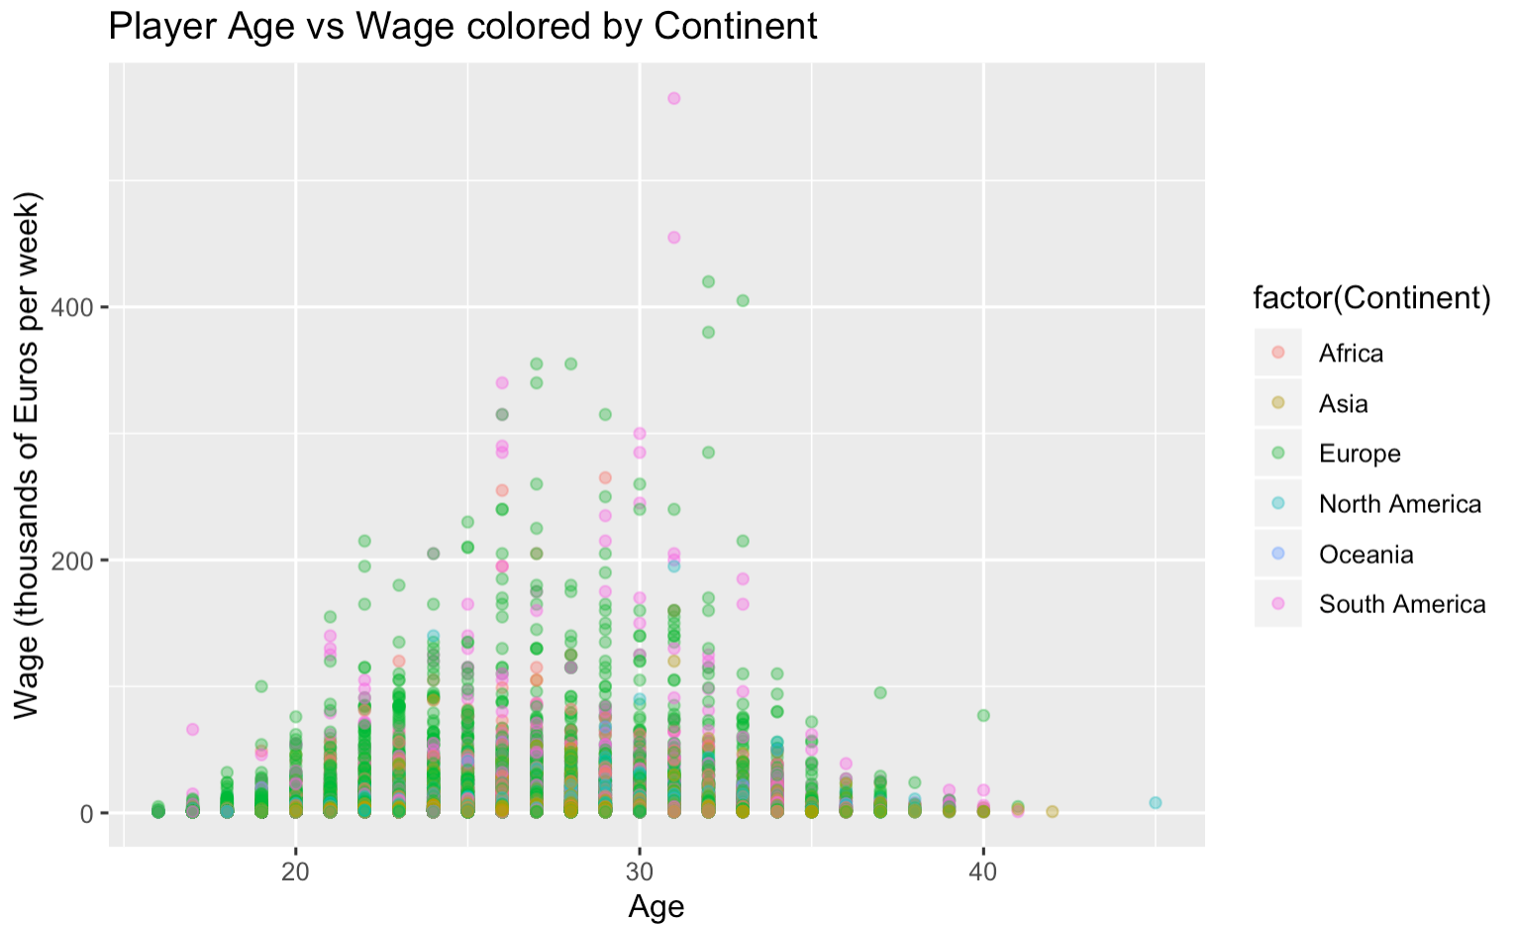
L. Messi
C. Ronaldo
Notes:
Alpha shading
Expand on - So we have player age vs wage. This is grouped by continent.
We can see Europe and South America Stand out has having higher wages to pay. This is not necessarily because the countries have more money(because South America certainly does not), but because the higher quality players or players with higher skill rating are located in European and South American leagues.
We can tell that most players will make the most amount of money between the ages of 25 and 30. After 30 you can see the wages for players tend to drop and drastically after 35. This is accurate because most soccer players retire after the age of 30 and most players are in their prime between 25 and 30.
We can see that our model also accurately depicts two outliers in the actual sport of soccer at the time. Messi and Ronaldo stand out far above any other players in the world due to their great accomplishments.

Slide 6
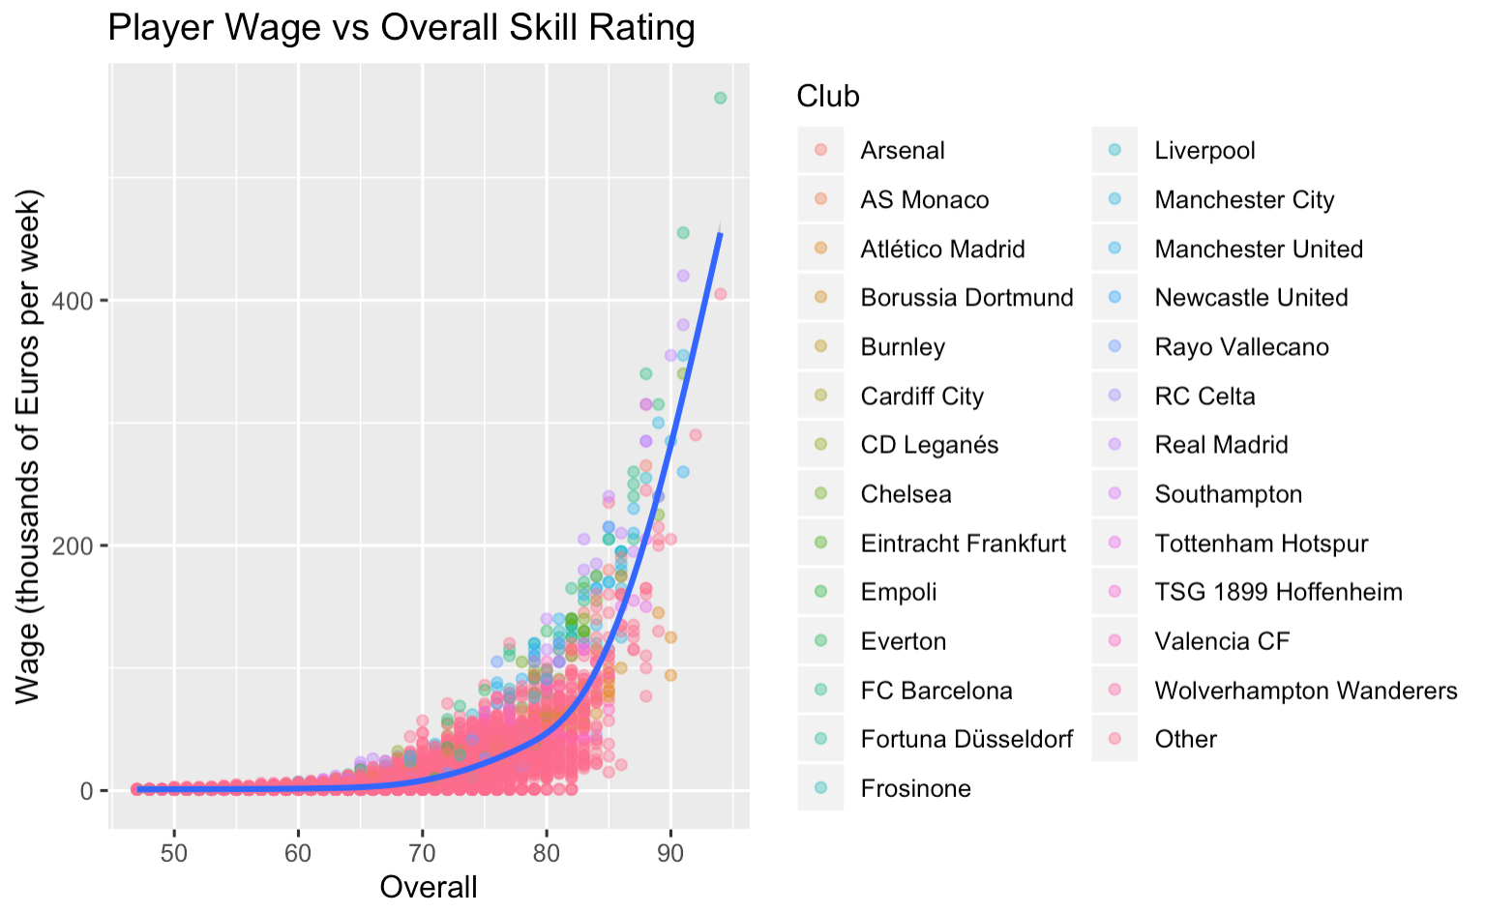
Data Exploration
Add cool charts and plots
Notes:
Here we have player wage versus overall skill rating. We can tell by the graph that between a skill rating of 50 - 80, there is not a large difference in wages players get paid.
However, once a player reaches an overall skill rating of 80 or more, there is an exponential increase in wage

Slide 7
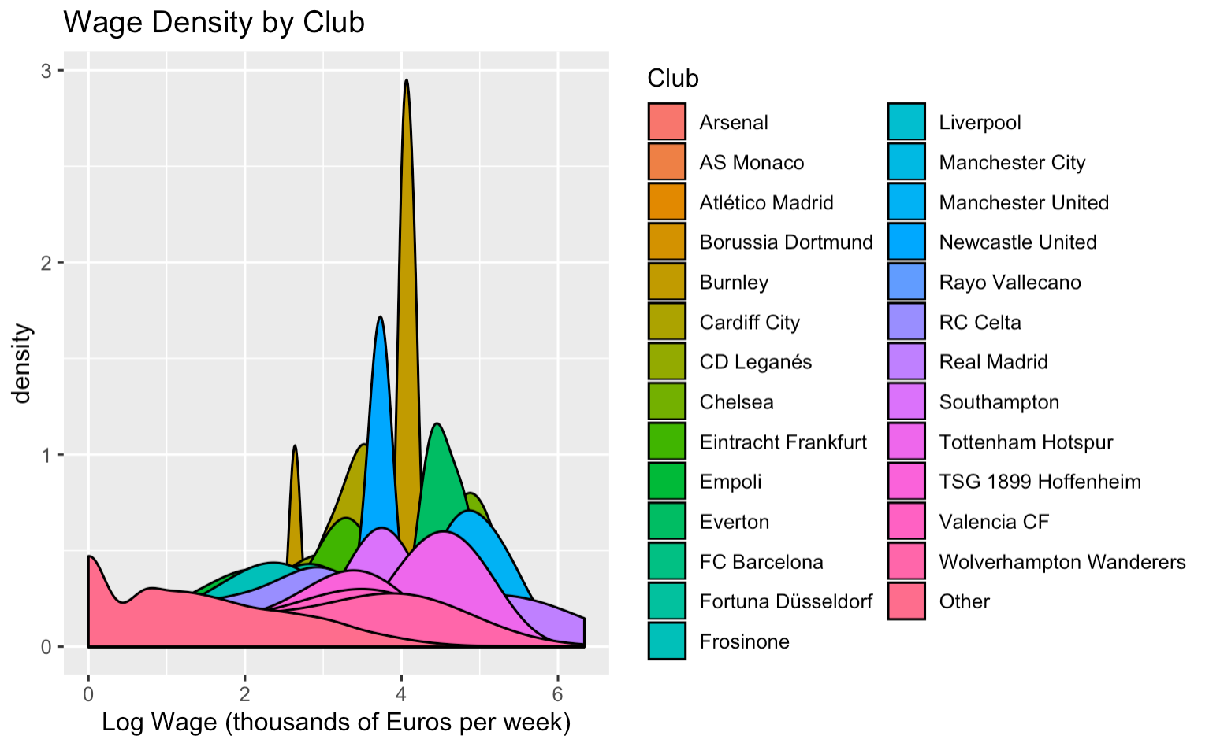
Data Exploration
Add cool charts and plots
Notes:
This graph shows us the wage density by club. We can see that only a few clubs pay a lot for few players( those would be outliers like Messi or Ronaldo. However, most clubs will pay a little less for more players.
Few clubs will pay more for less players while most clubs will pay less for more.

Slide 8
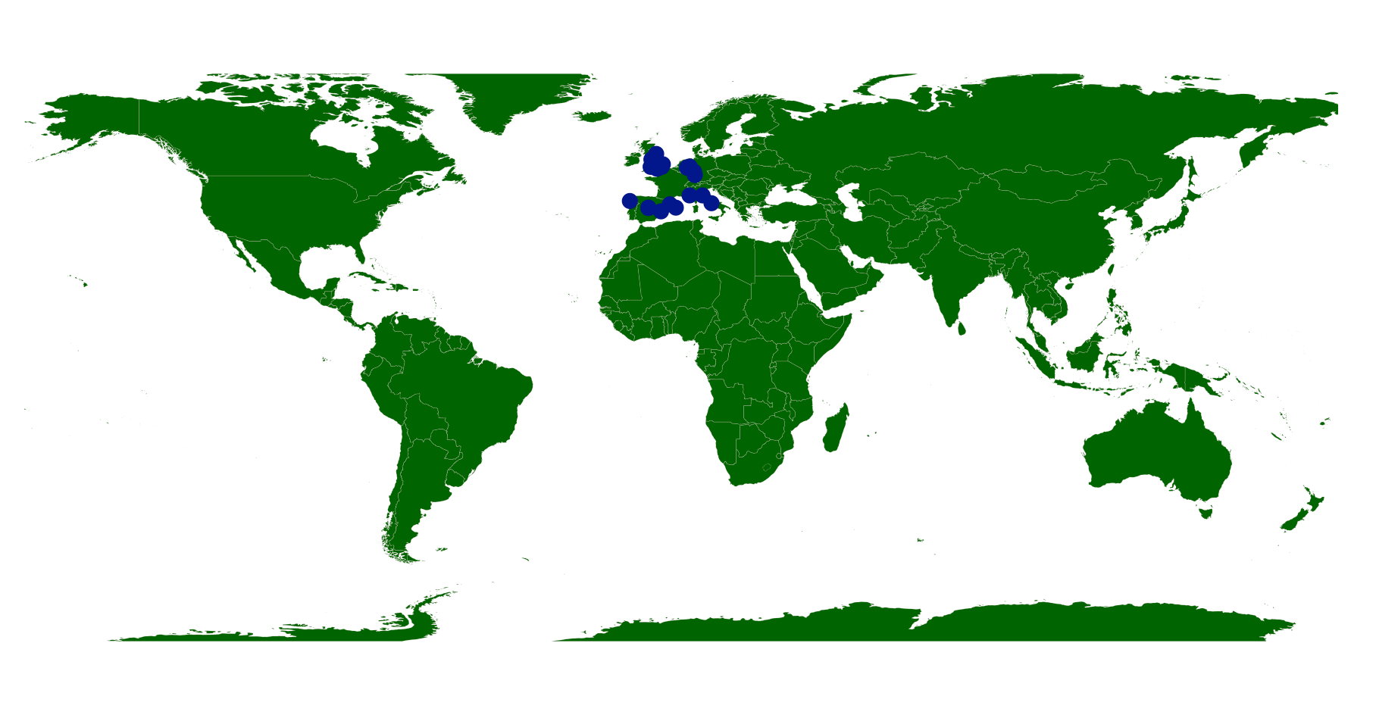
Top 28 Club Locations
Data Exploration
Add cool charts and plots
Notes:
This is a map that James Coded this in R where he located the longitude and latitude coordinates of each of our top 28 clubs and we can see that they are all in Europe. This goes to show that opportunity to make high wages in professional football are more abundant in Europe than any other continent.

Slide 9

Data Cleaning

Slide 10
Data Cleaning
Remove unneeded columns
Row #, ID #, Value, Release Clause, Name, Photo, Flag, Club Logo, Special, Body Type, Real Face, Jersey #, Loaned From, Joined Date
Removed symbols/letters in numeric columns
Wage & weight
Height to inches function removes apostrophe, replaces it with decimal and changes it to inches 5’11 to 71 inches
Factoring
Over 200 countries, so we changed countries to continents by a right_join
Factored clubs into top 28 & other

Slide 11

Models
Linear Regression, Linear Regression with Lasso Variable Selection, Elastic Net, Random Forest, Neural Network
Get it? He’s a model.

Slide 12
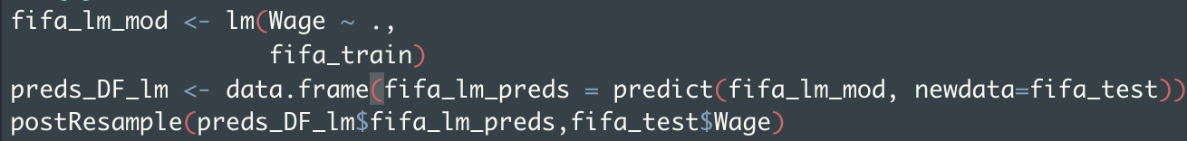
Multiple Linear Regression

Slide 13
Linear Model Diagnostics
Better than expected!
R2: 0.66
MAE: 6.4
RMSE: 13.8
Notes:
good start for models
All variables
Still not accurate
R squared, Mean absolute error, Root mean squared error

Slide 14
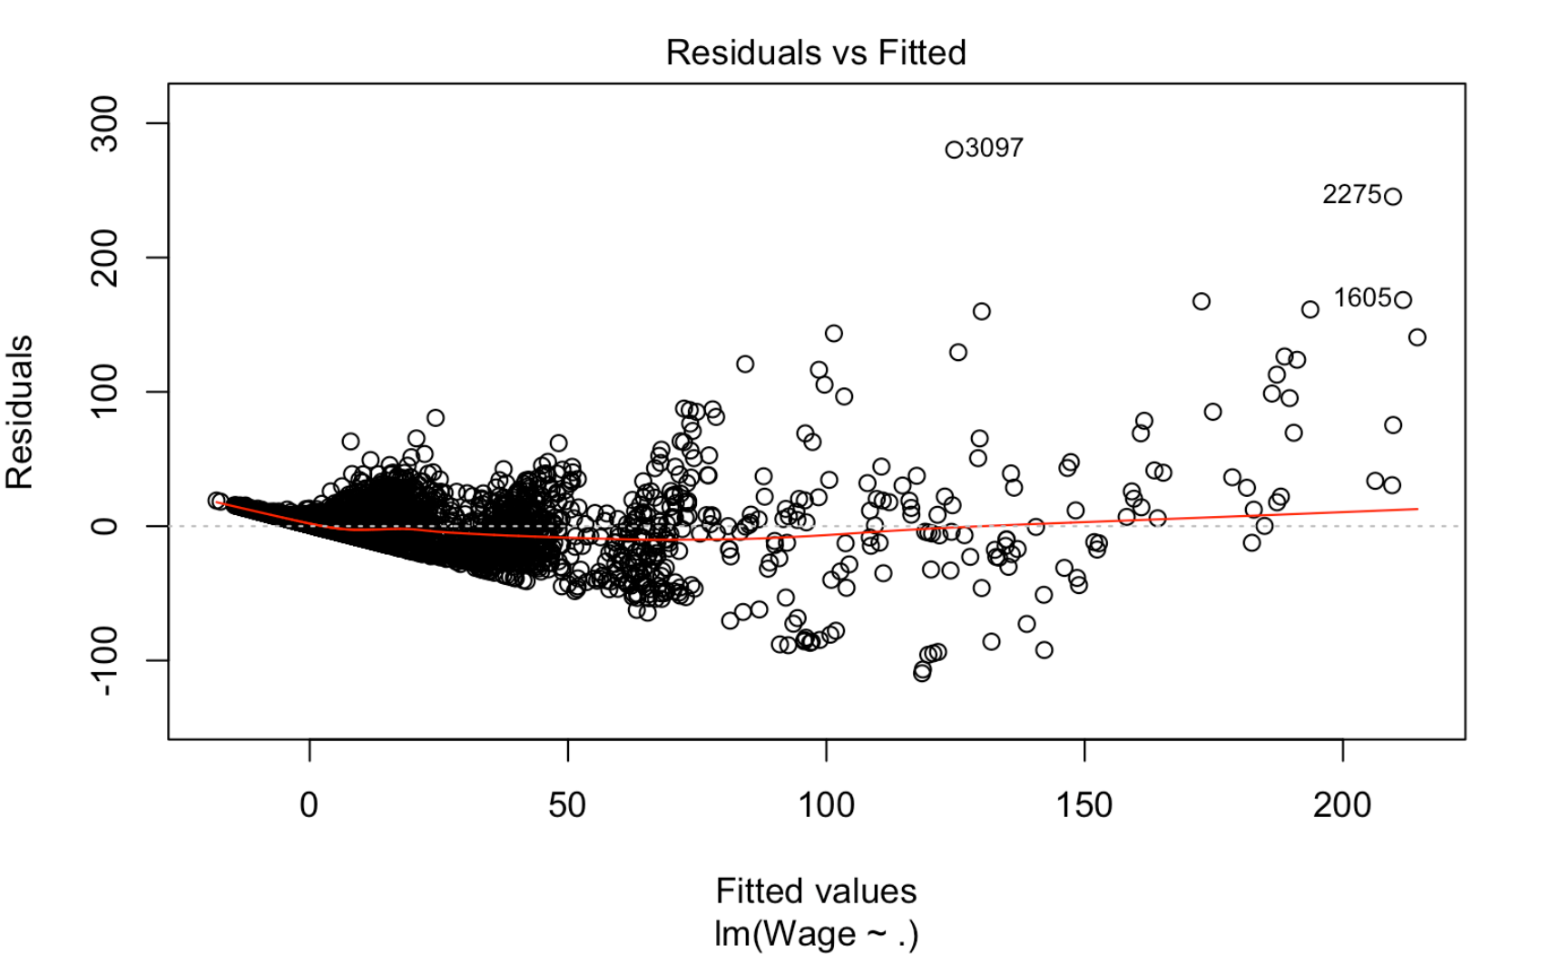
Heteroskedasticity
UPDATE plot(lm_model) !!!!!
Notes:
Non constant variance of error

Slide 15
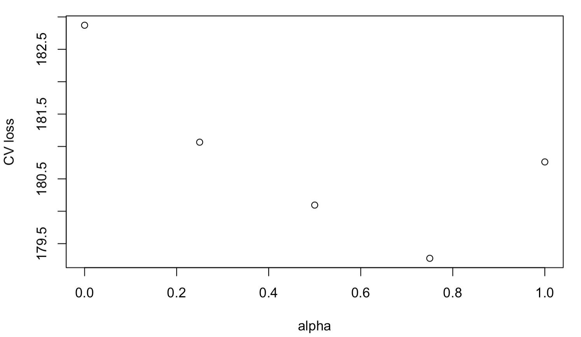
Elastic Net: Picking our Optimal Alpha

Slide 16
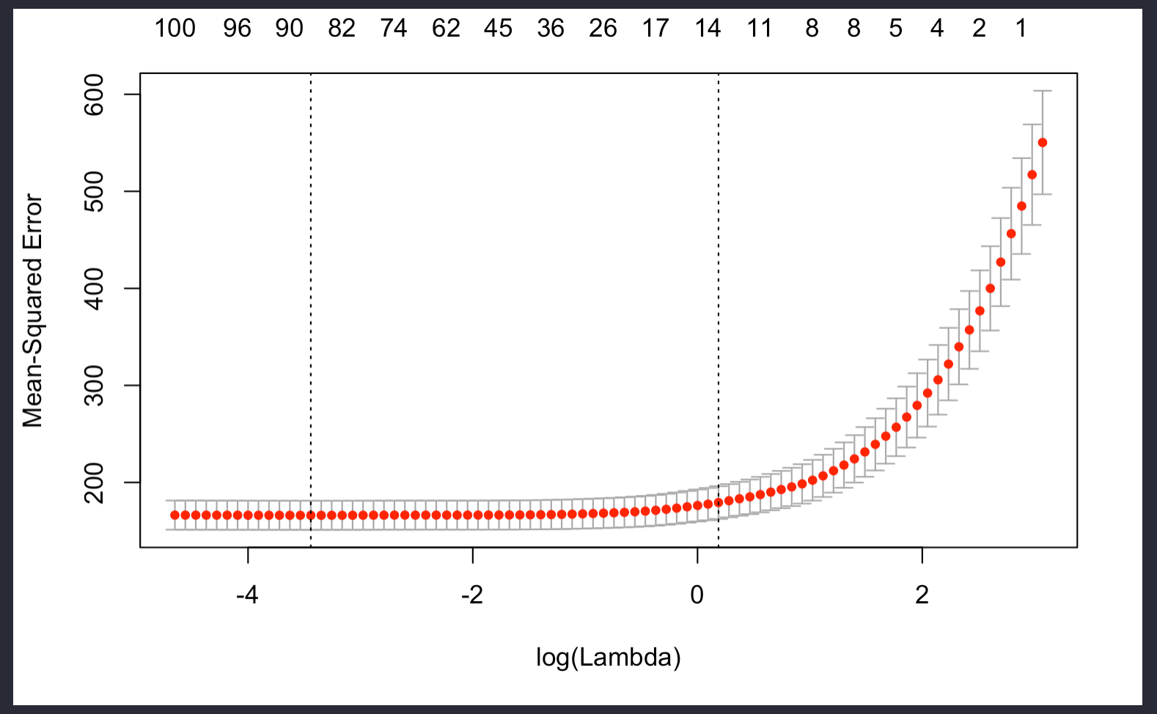
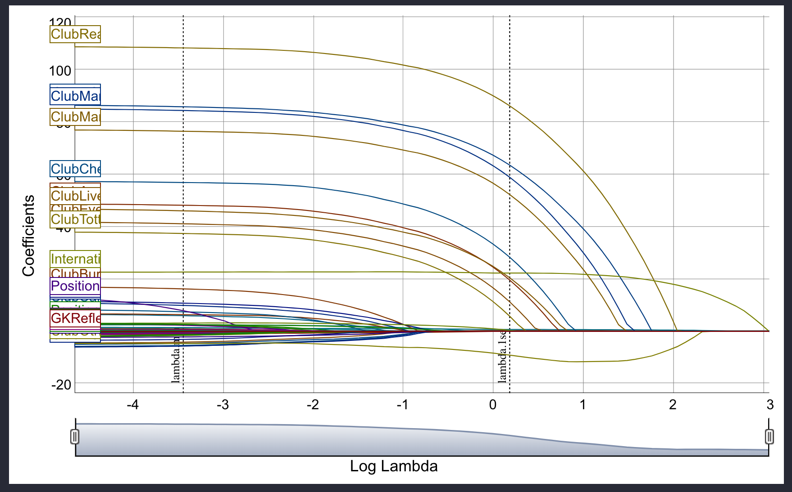
Clubs are some of the last variables to be set to zero
International reputation last variable set to zero

Slide 17
Elastic Net Model Diagnostics
R2: 0.63
MAE: 6.3
RMSE: 14.5

Slide 18
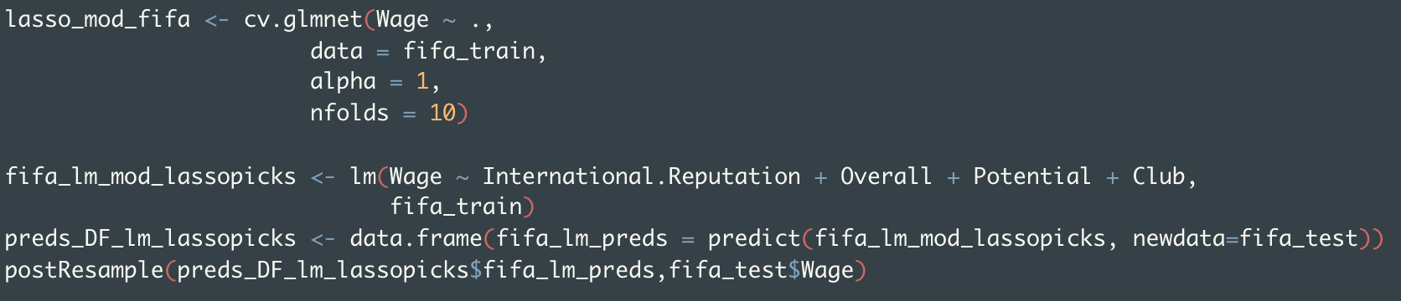
Lasso Model
*Please ignore our terrible naming conventions

Slide 19
Lasso Model
Lambda min picked 96 variables
Lambda 1se picked 8 variables:
International.Reputation
Overall
Potential
4 clubs and “Other” club factor

Slide 20
Lasso Model Diagnostics
R2: 0.65
MAE: 6.3
RMSE: 14

Slide 21
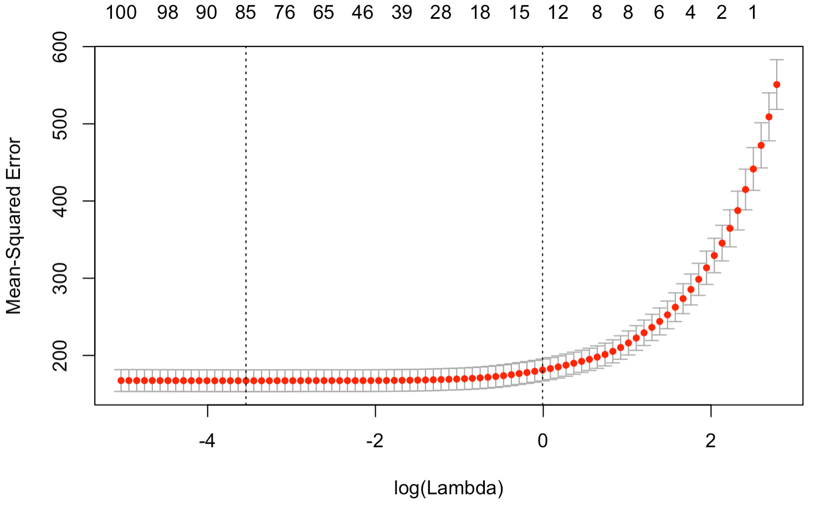

Slide 22
Post Lasso Estimator
We used the variable selections from Lasso (lambda.1se) to make a linear model to see how it performs compared to one with all variables

Slide 23
Post Lasso Estimator
LM with Lasso variables
R2: 0.649
RMSE: 14.04
MAE: 6.27
Regular LM
R2: 0.659
RMSE: 12.84
MAE: 6.39
Those 8 variables do almost as well as a model using all the variables

Slide 24
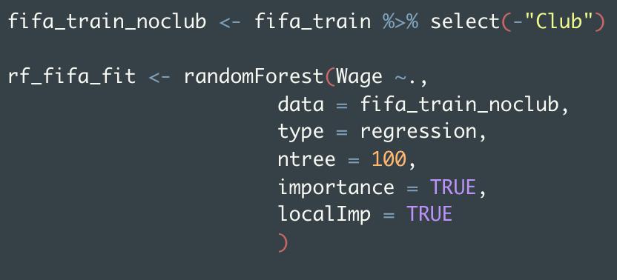
Random Forest
Used everything but Club because it had too many categories
Chose 100 trees to minimize error

Slide 25
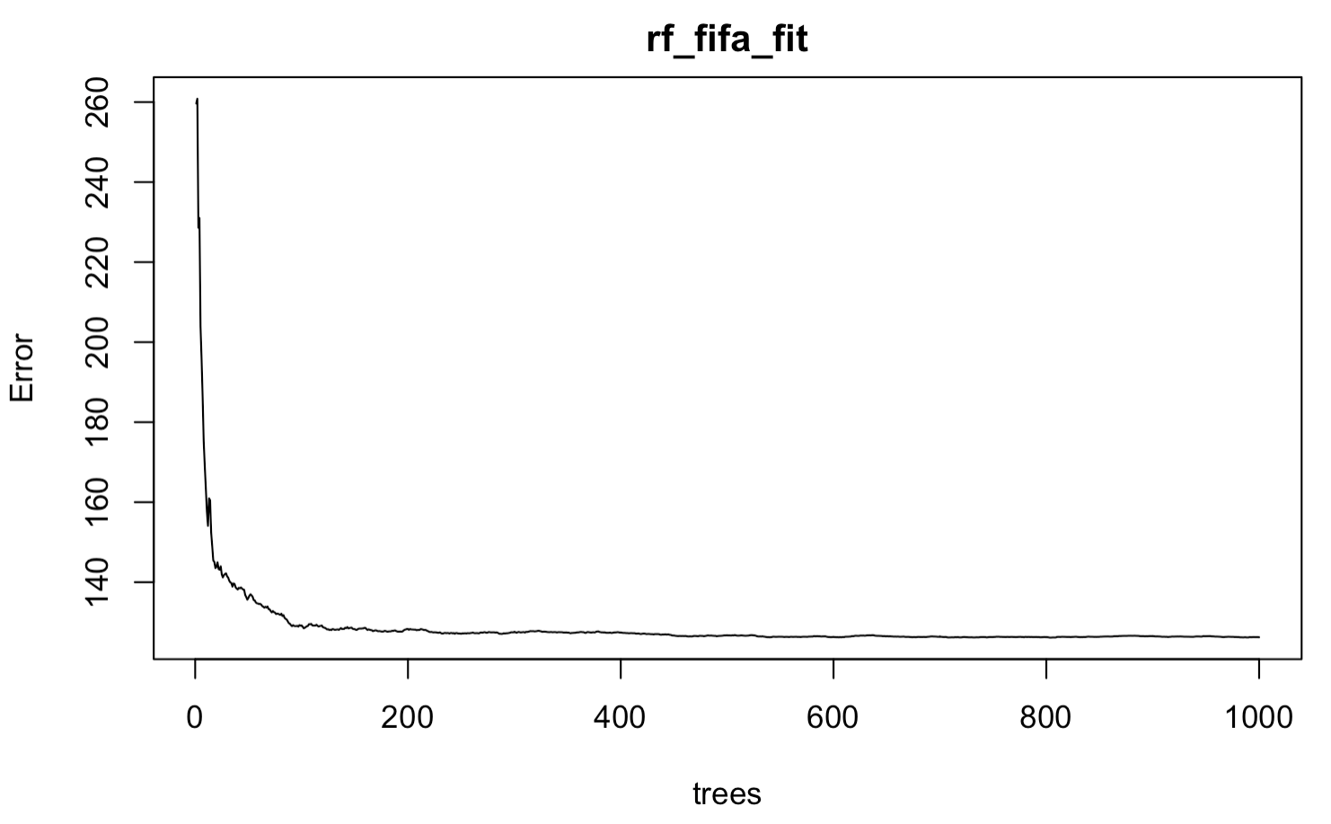

Slide 26
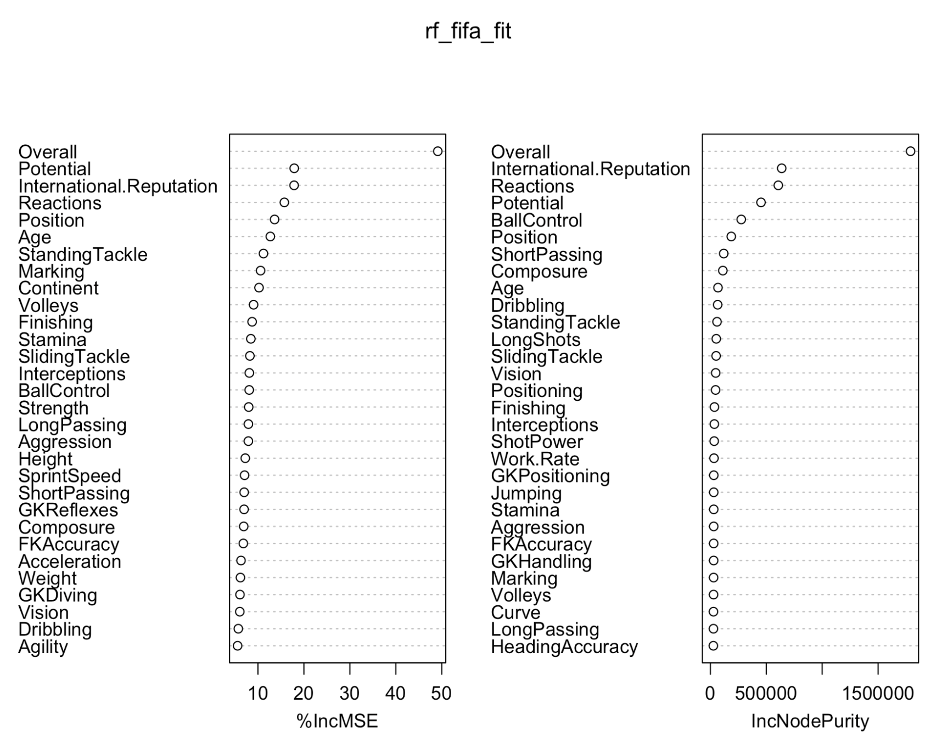
Top 5 variables
{

Slide 27
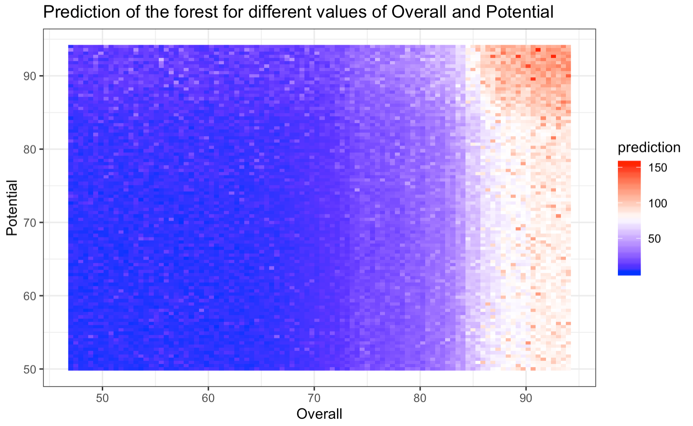
Notes:
Prediction interaction plot

Slide 28
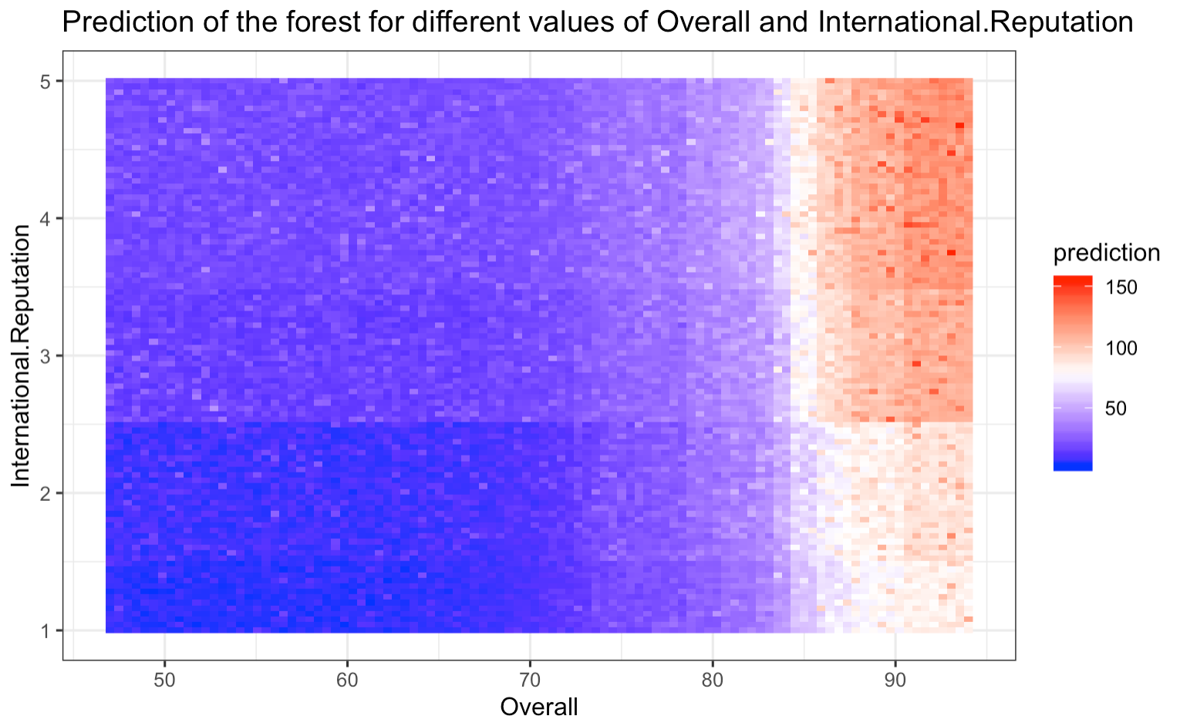
Notes:
Prediction interaction plot

Slide 29
Random Forest Model Diagnostics
R2: 0.79
MAE: 4.5
RMSE: 11.3

Slide 30
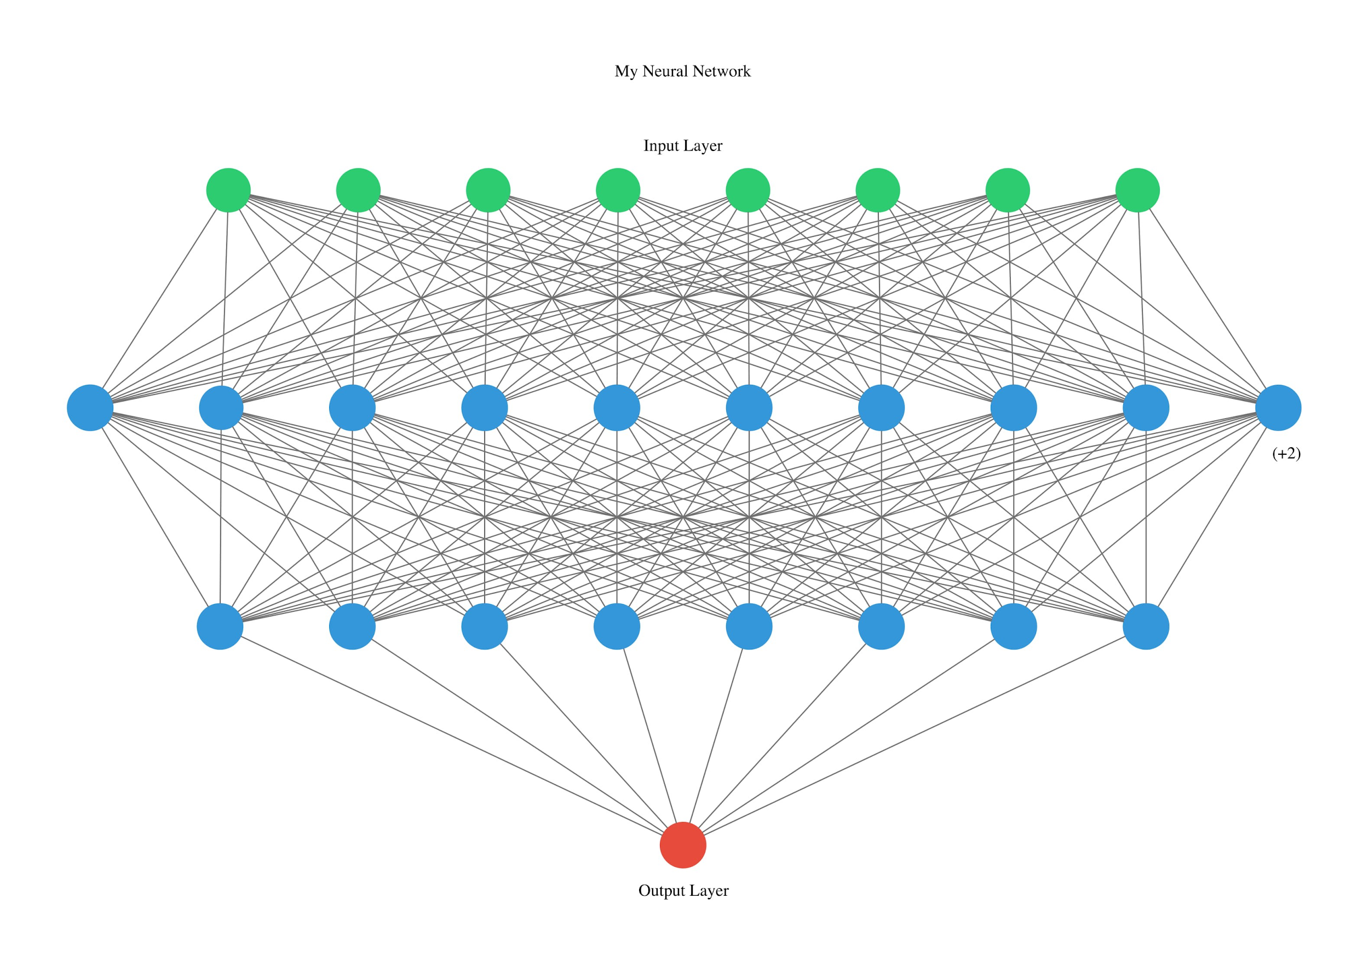
Neural Network
Feed input into network
Make prediction
Update weights through backpropagation

Slide 31
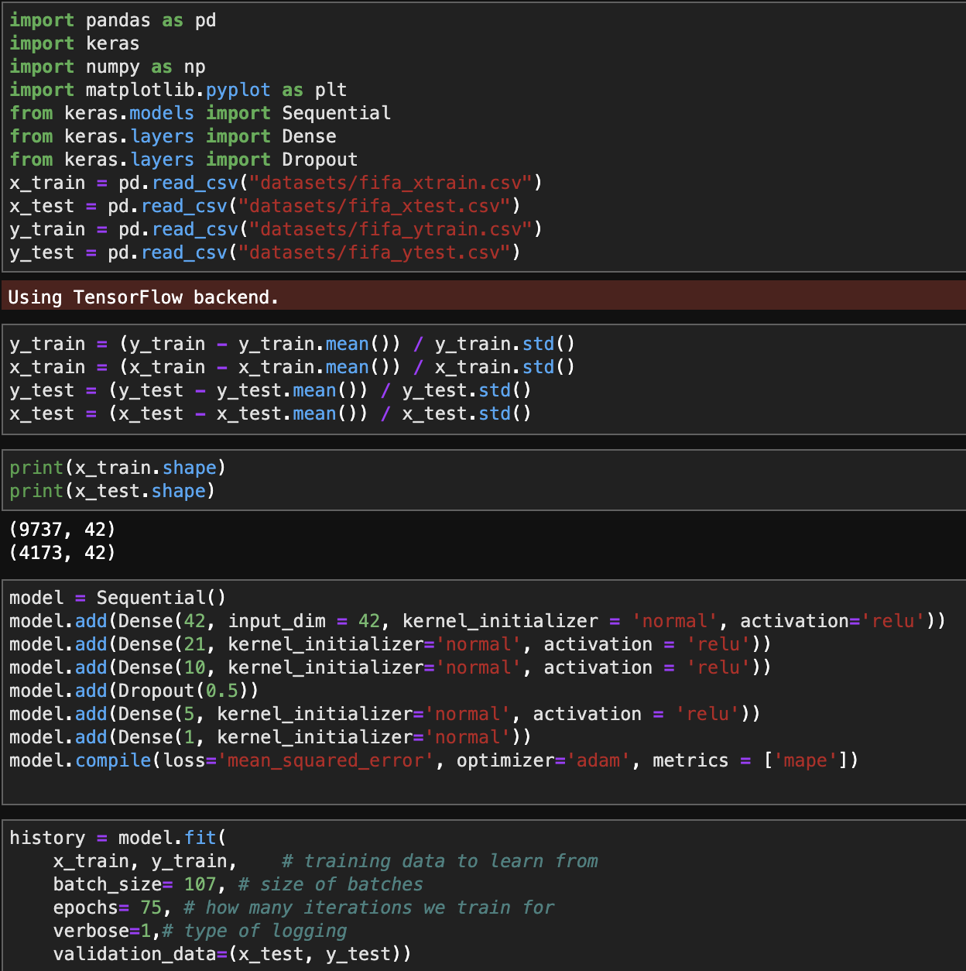
Neural Network

Slide 32
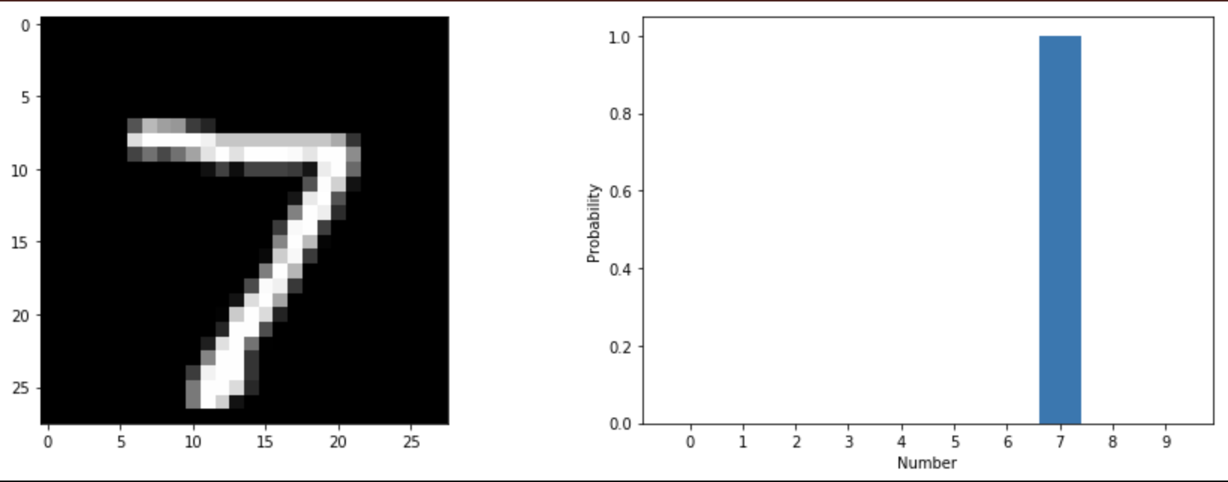
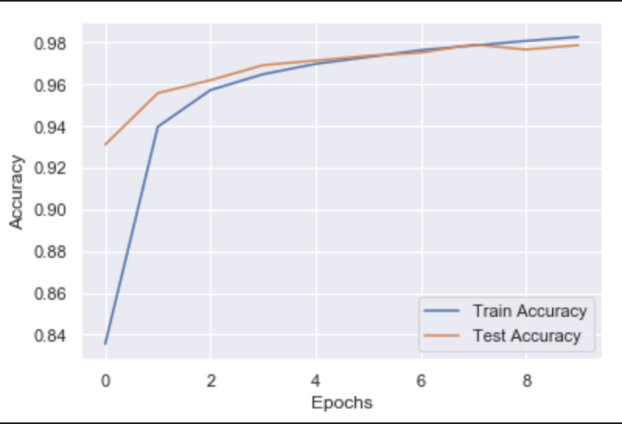
Neural Network
What it is supposed to look like

Slide 33
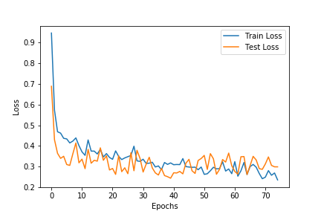
Neural Network Diagnostics
R2: 0.74

Slide 34

Results

Slide 35
Results
Most important variables across all models:
Overall skill rating
Potential rating
Club
International Reputation
Reactions
Position

Slide 36
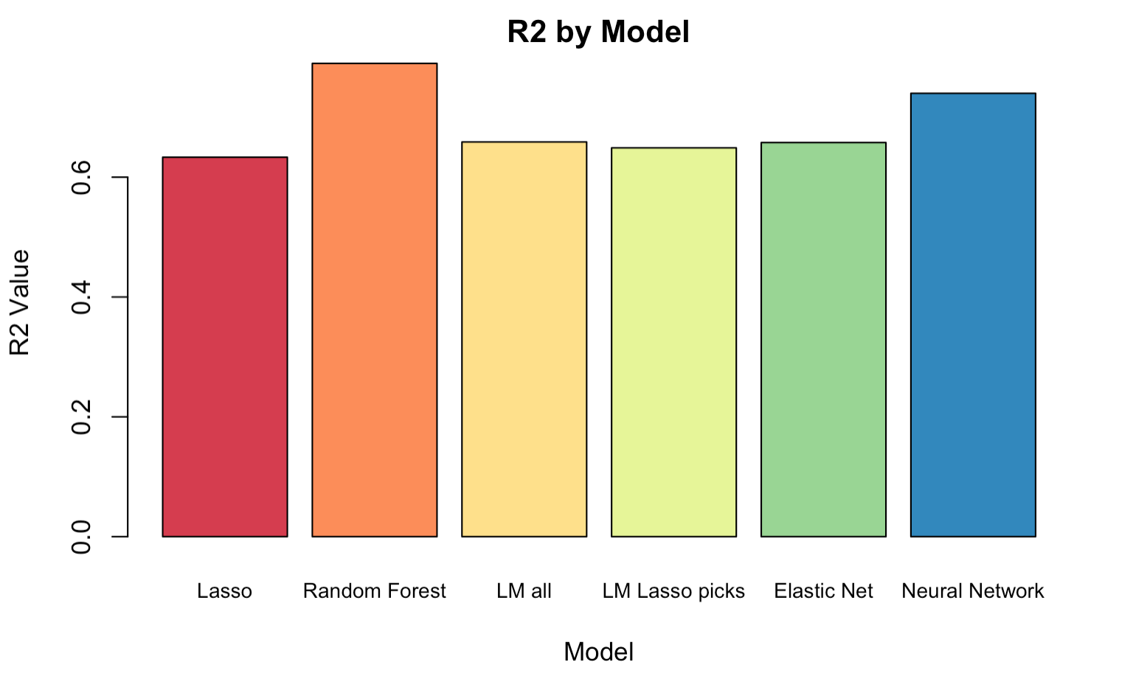

Slide 37
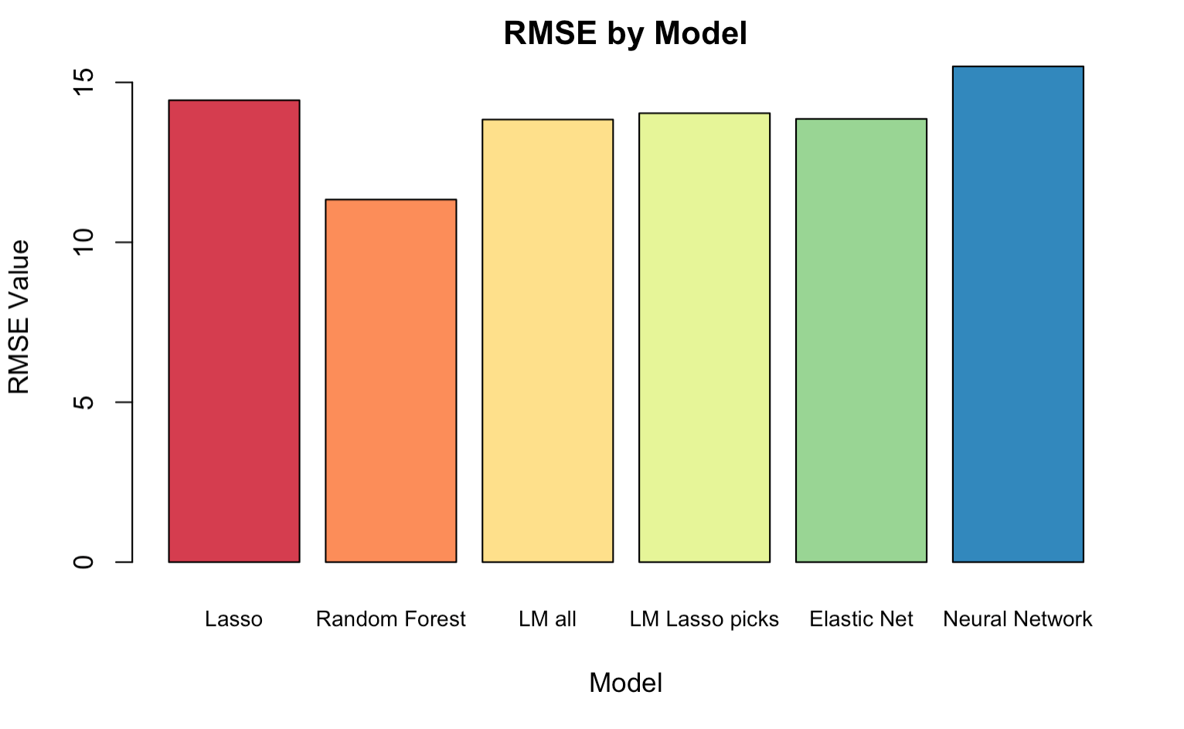

Slide 38
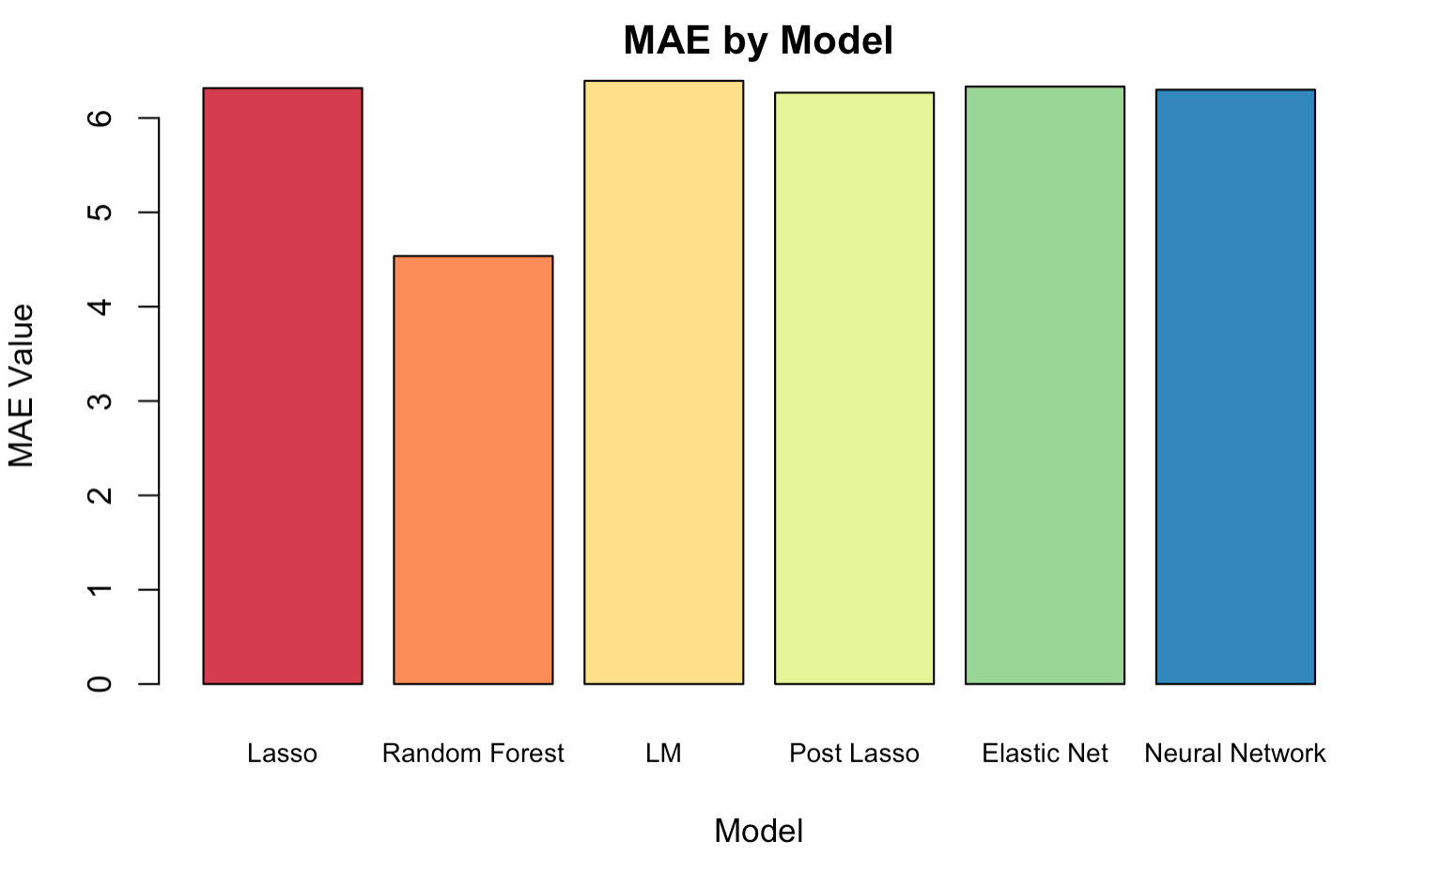

Slide 39
Conclusions

Slide 40
Conclusion
We learned that a few variables matter a lot, and everything else doesn’t really have an impact
Management can maximize their market cap use by hiring someone highly skilled in a low-earning position that can help the team a lot but won’t cost as much
Teams with lower international reputations can hire highly skilled players just under a rating of 80
Notes:
Managerial implications, what we learned, how can this help us manage a team better

Slide 41

THE END

Slide 42

Any questions?

